Slide 1
Prompt crafting techniques for GitHub Copilot
That every developer should know
Your Name
@your_name
Notes:
Housekeeping – drop your questions in the chat as we go, and we’ll save time at the end to get to them.

Slide 2
“How do I get the most out of GitHub Copilot?”
Notes:
One refrain that we’ve heard loud and clear from people is, how do I get the most out of this thing? I mean, these demos of Copilot writing a regex are cool and all, but how do I really level up my programming game with GitHub Copilot and become an AI programming expert?
But first we need to understand what GitHub Coplot actually is.

Slide 3

Your AI Pair Programmer
Notes:
GitHub Copilot is advertised as Your AI Pair Programmer. But what exactly does that mean?
The first thing that you need to know is that GitHub Copilot is not an AI. It is the name of a suite of AI Tools that you’ll find in a lot of places – including GitHub.com and Visual Studio.

Slide 4
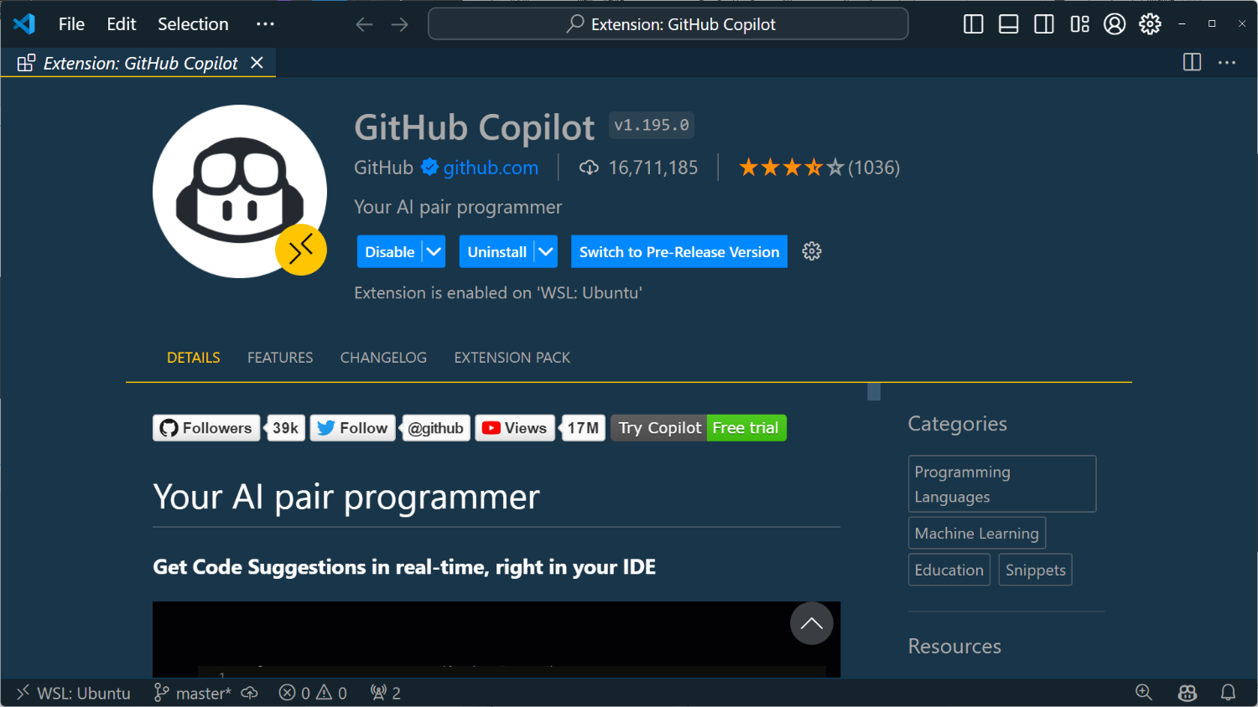
Notes:
As far as VS Code goes, it is an extension that you’ll need to install. You’ll also need an active GitHub Copilot subscription. There is a trial if you do not have one and are a new customer.
Note that there are actually two extensions in the VS Code marketplace for GitHub Copilot – one is called GitHub Copilot and the other is called GitHub Copilot Chat – but you can install either and you will get both. Each extension installs the other as both are required for the complete Copilot experience.
But there is something that GitHub Copilot is NOT, and that is it is not an AI.
It is the mechanism by which you the developer can interface with the AI in a variety of ways via the editor.

Slide 5

System: You are a friendly coding assistant…
User: Create a webserver in TypeScript”
“Create a webserver in TypeScript”
```javascript
import Express, { Request, Response } from “express”
```
System: You are a friendly coding assistant…
User: Create a webserver in TypeScript”
Assistant: Sure! Here’s a web..
Notes:
Lets’s say you make a request such as “create a webserver in typescript”, GitHub Copilot does a few things..
It enables you to make that request with some sort of user interface element – we’ll look at these different interaction models in a moment.
It takes your request and it adds to it something called a “system prompt”, as well as any context – other information or code that it thinks will be helpful in answering your question – and creates a prompt.
It identifies which GPT model to use – GPT 3.5 is fast, but 4.0 is accurate – so it tries to pick the right one based on the requested interaction.
It sends the request to the OpenAI model
It then parses the response from the model so that it can provide that code to you in the requested interaction format – either in chat in the editor or by adding code directly to your file.

Slide 6

Your Pair Prompt Engineer
Notes:
Said to say, GitHub Copilot is your AI pair programmer, but it is also your Pair Prompt Engineer.
A huge part of what GitHub Copilot does is write prompts so that you don’t have to.

Slide 7
DEMO
Notes:
OK – now that we know what GitHub Copilot is actually doing in VS Code, let’s dive in and take a look at some advanced prompt crafting techniques to help you become a GitHub Copilot expert.

Slide 8
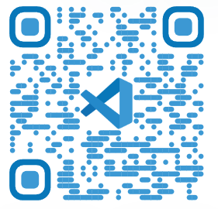
Thank You!
Burke Holland
@burkeholland
Burke Holland
aka.ms/learn-copilot
Notes:
GitHub Copilot is not an AI. It is the implementation of the AI in the tool you are using – in this case, VS Code.
When you make a request such as “create a webserver in typescript”, GitHub Copilot does a few things..
It enables you to make that request with some sort of interaction – we’ll look at these different interaction models in a moment.
It takes your request and it adds the system prompt PLUS any context – other information or code that it thinks will be helpful in answering your question – and creates a prompt. It identifies which GPT model to use – GPT 3.5 is fast, but 4.0 is accurate – so it tries to pick the right one based on the requested interaction.
It sends the request to the OpenAI model
It then parses the response from the model so that it can provide that code to you in the requested interaction format – either in chat in the editor or by adding code directly to your file.
Said to say, GitHub Copilot is your AI pair programmer, but it is also your Pair Prompt Engineer.

